Slide 1
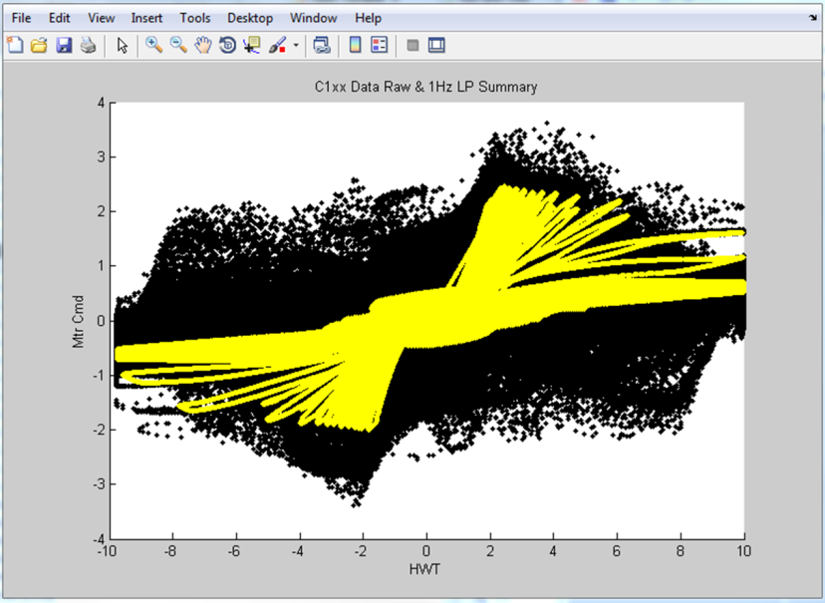
SE02 – Global Cross Check
Description
Input torque to Output command correlation diagnostic for added systematic protection
Not intended to enforce safety goal
Motivation (Score 4)
Requested by GM on K2xx, required for C1xx
Deliverables
Modeled FDD including test plan and calibration strategy
Successful implementation on C1xx and BMPV
Timing
PSA Software Release 2 (FDD must be approved by June 15)
C1xx – targeting post-IVER release
Team Members/Customers
Scott Weiss / C1xx and PSA PDT

Slide 2
SE02 – Global Cross Check
Status
Implementation in PSA code is in process
Calibration procedure is written
Calibration procedure will be verified with PSA and tested in vehicle
Challenges
Reduced value since it does not enforce the safety goal
Next Steps
Implement in vehicles and evaluate for robustness
Eventually replace this function with true ASIL decomposition over time

